Slide 1
ECR proposal
Exploring patients’ experiences with nerandomilast: a longitudinal qualitative research among IPF patients
For sharing
Guoze Feng
April 2026

Slide 2
Executive Summary
A longitudinal qualitative research among IPF patients
Background
PEC Discussion
Aligned with the strategy outlined in the global RWE plan
Included in the local evidence generation plan after multiple discussions, with budget secured
Discussed with the Peking University and clinical experts
Inputs obtained from the asset team
Endorsed by INFL CEC in April
Team Proposal
Evidence generation through an ECR in collaboration with Peking University and clinical experts from four hospitals
Request for PEC
For Sharing

Slide 3
Background
  Nerandomilast has launched in China in 2026, providing a novel therapeutic option for patients with IPF and PPF
  While clinical trials have established its efficacy and safety, patients' real‑world treatment experiences remain unknown, including treatment initiation, adherence, and daily life impact
  Understanding real‑world patient experience is critical to inform future clinical practice, including treatment decision‑making and long‑term management strategies
  Insights from physicians will support optimized patient education and long-term management
  Data from study 1199-0562 on unmet needs in IPF patients provides a critical foundation for this qualitative study
Key findings from
1199-0562
This study highlights that patients’ unmet needs and treatment expectations extend beyond symptom relief and disease control, including hopes for fewer side effects, improved tolerability, and greater affordability.

Slide 4
Objectives
This study will benefit…
Inform clinical practice and treatment decision‑making
Support development of patient education materials
Identify unmet needs in adherence and symptom management
Inform post‑marketing strategies
Inform future RWE study designs
  To describe patient characteristics and the disease diagnosis journey among IPF patients initiating nerandomilast
  To describe patient experiences following nerandomilast treatment initiation, including symptoms, quality of life and adherence etc.
  To explore the potential underlying factors associated with changes of patient experience
  To understand HCP-patient interaction in the management of IPF
  To collect physician’s experiences and insights on the use of nerandomilast
  To identify gaps in patient support and education

Slide 5
Study design: longitudinal qualitative research
This study is purely observational. No study medication or intervention will be provided. Patient’s diagnosis and treatment decisions will follow standard clinical practice.
with prior AF therapy (n=28)
IPF patients initiating nerandomilast (n≈56*)
Screening
without prior AF therapy (n=28)
# Survey
1
2
3
4
Months
0
1~2
6
12
Baseline
nerandomilast initiation
End of study
Potential extension
Physicians
(n ≈12*)
One round of in‑depth interview in the later stage of the study with physicians who have experience using nerandomilast
*An estimated 24 participants per group will complete three rounds of interviews. Based on the principle of information saturation in qualitative research, the actual sample size may be adjusted.

Slide 6
Data collection and analysis
Expected key outcomes
Patient Profile and patient Journey
Patient‑reported experience of IPF and nerandomilast
Experience changes over time (baseline → early → longer term)
Underlying factors associated with experience changes
Physician perspectives on patient needs and treatment decisions
Eligible patients will be enrolled by physicians
Trained qualitative researchers will conduct face-to face interview
All interviews will be audio‑recorded and transcribed verbatim into text format
Data will be analyzed using a systematic thematic analysis approach, with software NVivo 15.0

Slide 7
Timeline, budget and publication plan
Milestone | Best case | Base case
CEC/PEC endorsement | 04/2026 | 04/2026
Global release | 07/2026 | 08/2026
Protocol approval | 09/2026 | 10/2026
IRB/IEC approval | 10/2026 | 11/2026
Contract sign-off | 12/2026 | 02/2027
FPI | 03/2027 | 04/2027
LPI | 06/2027 | 08/2027
LPO | 12/2027 | 02/2028
Study report | 05/2028 | 07/2028
Publication plan
  1~2 SCI manuscripts
  2~4 conference abstracts
  Investigators will be involved in above publications and may also lead publications using the study data
Study budget
临床团队（院内立项、伦理、患者推荐、患者管理） | 200,000元/site*4site | 800,000
方法学团队（数据收集、数据管理） | 200,000元/site*4site | 800,000
Leading PI 团队（项目管理、方案设计、数据分析、报告及文章撰写） |  | 1,461,000
管理费、税费 |  | 928,000
勃林格内部费用 |  | 150,000
合计 |  | 4,139,000
*Interim analysis will be conducted after LPI

Slide 8
Study sites and investigators
方法学团队：
方法学
临床
  成员
    北京大学第三医院临床流行病学研究中心：褚红玲 （Leading PI）、闫碧轩、刘宁；詹思延教授和沈宁教授为科学顾问
    浙江中医药大学：周云仙
    四川大学华西第二医院：方厢
    复旦大学：胡雁
  主要职责
    研究方案设计
    定性访谈实施
    数据分析、研究报告及文章撰写
    与各参研医院签署研究合同并拨付研究经费
  参研医院
    首都医科大学附属朝阳医院：詹曦
    浙江大学医学院附属第一医院：周建娅
    四川大学华西医院：杨婷
    上海市肺科医院：张苑
  主要职责
    医院内研究立项及伦理
    推荐符合条件的患者参与研究与随访
    推荐医生参与医生访谈
    参与研究方案、报告、文章撰写及审阅

Slide 9
Backup slides

Slide 10

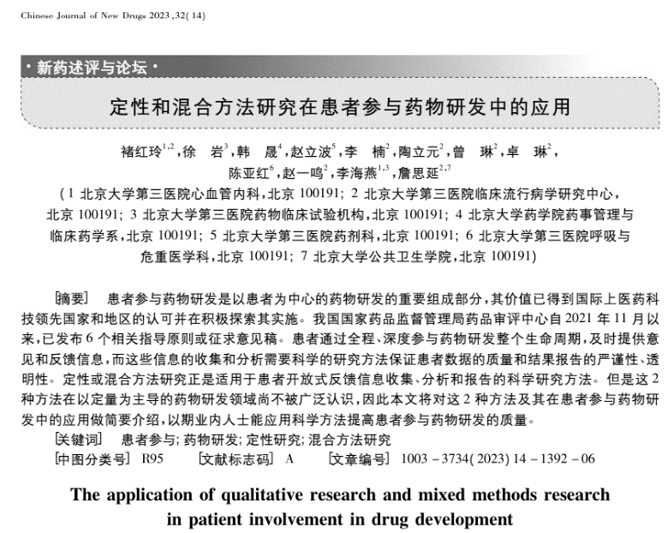
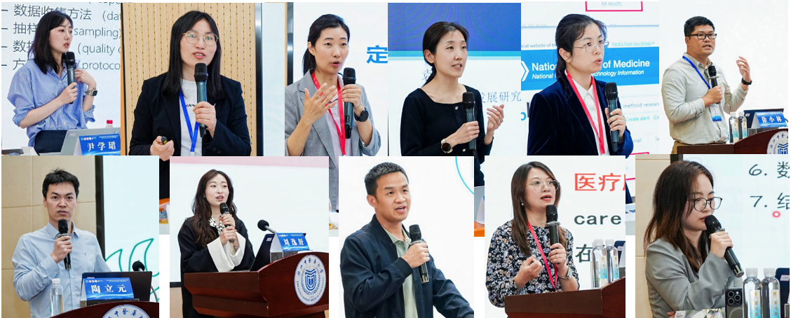

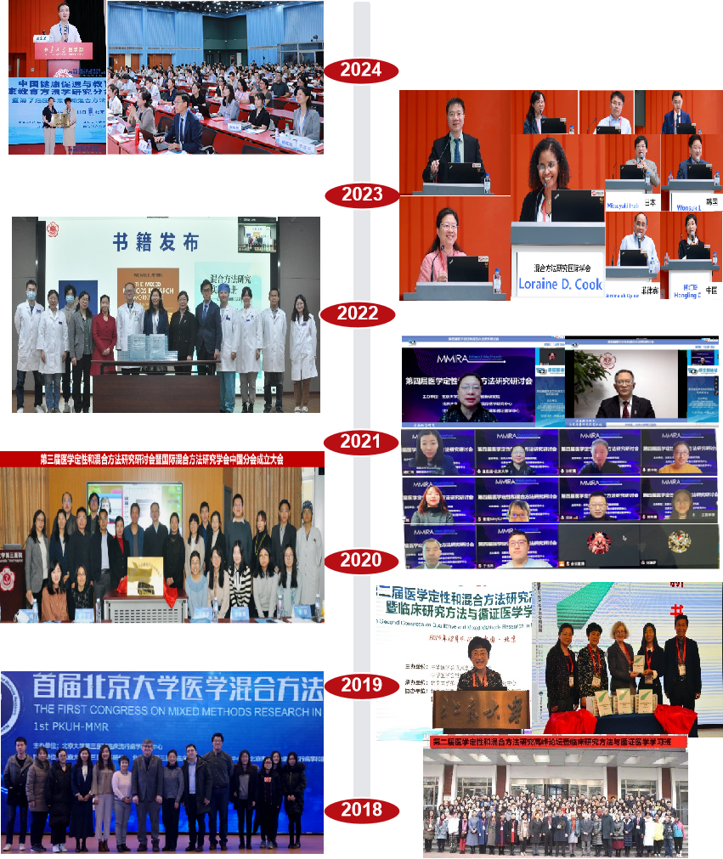










北大团队在中国定性和混合方法研究中的推动与引领
2025
10
2019，2022年出版，译著
国内编写，即将出版
三本书主审：詹思延

Slide 11


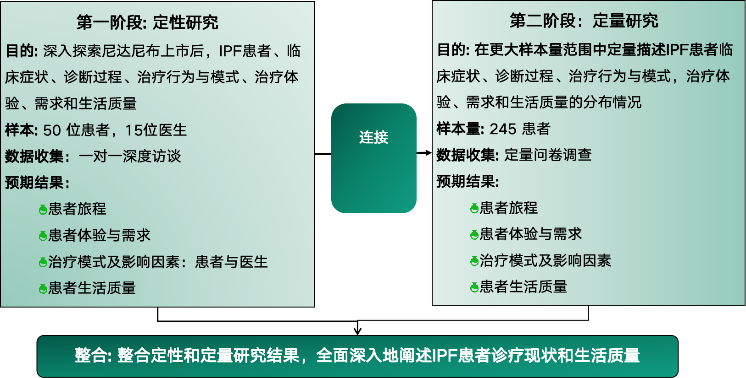
  在研项目：中国特发性肺纤维化的诊疗现状及生活质量研究（1199-0562IPFLife）
研究设计
褚红玲 北京大学第三医院临床流行病学研究中心
临床研究方法学博士，副研究员，硕士生导师，博士后合作导师，密歇根大学、牛津大学访问学者
主要研究方向为：临床研究设计与实施、实施科学、患者体验与行为研究，尤其聚焦于定性与混合方法研究。
担任国际混合方法研究学会管委会成员、中国分会秘书长，中国健康促进与健康教育协会健康教育方法学研究分会秘书长，STAR指南评级专业委员会康复医学专科副主任委员等。
主译书籍《混合方法研究实践手册—设计、实施和发表》、《定性研究在随机对照试验中的应用指南》，参编《The SAGE Handbook of Mixed Methods Research Design》、《临床研究方法与实用技巧》方法学系列丛书。正主编书籍《混合方法研究理论与实践》
主持国自然青年课题1项，北京市自然科学基金面上项目1项，牵头全国多中心罕见病研究1项，其他各类横纵向课题7项。在Lancet rheumatology，JAMA Network Open，中华医学杂志等中英文期刊参与累计发表中英文文章100余篇。
研究发表
研究方案：BMJ Open已发表
研究结果：文章发表1篇，投稿中2篇
多次国内外会议汇报和交流

